Slide 1
CYBR 493A
Module 4: MAKING PAPER CRYPTOGRAPHY TOOLS
Chapter 1: Cracking Codes with Python
Pages 37 - 47

Slide 2
TOPICS
What is cryptography?
Codes and ciphers
The Caesar cipher
Cipher wheels Doing cryptography with arithmetic
Double encryption

Slide 3
Before we start writing cipher programs, let’s look at the process of encrypting and decrypting with just pencil and paper. This will help you understand how ciphers work and the math that goes into producing their secret messages. In this chapter, you’ll learn what we mean by cryptography and how codes are different from ciphers. Then you’ll use a simple cipher called the Caesar cipher to encrypt and decrypt messages using paper and pencil.

Slide 4
What Is Cryptography?
Historically, anyone who has needed to share secrets with others, such as spies, soldiers, hackers, pirates, merchants, tyrants, and political activists, has relied on cryptography to make sure their secrets stay secret.
Cryptography is the science of using secret codes.

Slide 5
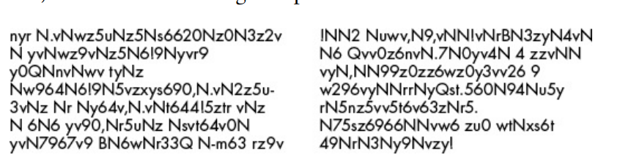
What Is Cryptography?
The text on the left is a secret message that has been encrypted, or turned into a secret code. It’s completely unreadable to anyone who doesn’t know how to decrypt it, or turn it back into the original English message.
The message on the right is random gibberish with no hidden meaning

Slide 6
Encryption Vs. Decryption
Encryption keeps a message secret from other people who can’t decipher it, even if they get their hands on the encrypted message.
An encrypted message looks exactly like random nonsense.
Decryption brings the text to life using a key used to translate the encrypted text to an understandable text

Slide 7
Definitions
A cryptographer uses and studies secret codes.
Of course, these secret messages don’t always remain secret.
A cryptanalyst, also called a code breaker or hacker, can hack secret codes and read other people’s encrypted messages.
This book teaches you how to encrypt and decrypt messages using various techniques.

Slide 8
Codes vs. Ciphers
Unlike ciphers, codes are made to be understandable and publicly available.
Codes substitute messages with symbols that anyone should be able to look up to translate into a message.
In the early 19th century, one well-known code came from the development of the electric telegraph, which allowed for near-instant communication across continents through wires (Morse Code)

Slide 9
Codes vs. Ciphers
In contrast with codes, a cipher is a specific type of code meant to keep messages secret.
You can use a cipher to turn understandable English text, called plaintext, into gibberish that hides a secret message, called the ciphertext. (i.e., Shifrah in Arabic شفره).
A cipher is a set of rules for converting between plaintext and ciphertext.

Slide 10
Codes vs. Ciphers
These rules often use a secret key to encrypt or decrypt that only the communicators know.
In our book, you’ll learn several ciphers and write programs to use these ciphers to encrypt and decrypt text.
But first, let’s encrypt messages by hand using simple paper tools.

Slide 11
Title: The Birth of Morse Code
Early 19th century
Electric telegraph development
Near-instant global communication
Replaced slow horseback letter delivery

Slide 12
Title: Morse Code Basics
Telegraph limitations: "dot" and "dash" pulses
Encoding: Translate English to pulses
Decoding: Translate pulses to English
Morse code: The code of telegraph and radio communication

Slide 13
Encoding Vs. Decoding
To convert letters of the alphabet into these dots and dashes, you need an encoding system to translate English to electric pulses.
The process of converting English into dots and dashes to send over a telegraph is called encoding, and the process of translating electric pulses to English when a message is received is called decoding

Slide 14
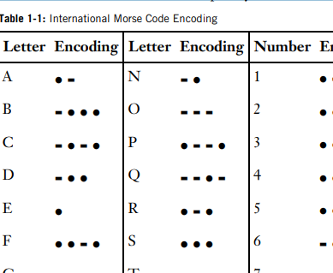
Morse Code Encoding
The code used to encode and decode messages over telegraphs (and later, radio) was called Morse code, as shown in Table 1-1. Morse code was developed by Samuel Morse and Alfred Vail.

Slide 15
The Caesar Cipher
Named after Julius Caesar (2000 years ago)
Simple and easy to learn
Vulnerable to cryptanalysis due to its simplicity
Valuable as a learning exercise

Slide 16
How the Caesar Cipher Works
Substitutes each letter by shifting the alphabet
Example: Caesar shifted the alphabet down by three
A becomes D, B becomes E, and so on
Handles end-of-alphabet shifts by wrapping around
Demonstrating encryption with the Caesar cipher

Slide 17
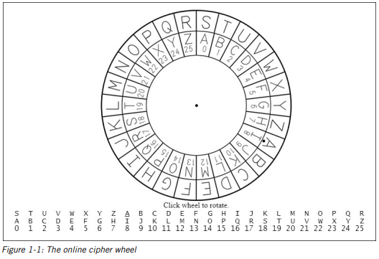
The Cipher Wheel
Simplifying Caesar cipher with a cipher wheel
Two rings with 26 slots each (for a 26-letter alphabet)
Outer ring represents plaintext alphabet
Inner ring represents corresponding ciphertext letters
Inner ring numbered 0 to 25 for encryption key
Circular shift, key > 25 wraps around (e.g., 26 = 0, 27 = 1)

Slide 18
Accessing the Virtual Cipher Wheel
Access the virtual cipher wheel online at https://www.nostarch.com/crackingcodes/
Figure 1-1 provides a visual representation
Click and drag to spin the wheel for desired configuration
Click again to stop the wheel from spinning
Offers an interactive learning experience

Slide 19
Printable Paper Cipher Wheel
Printable paper cipher wheel available on the book's website
Cut out two circles, place smaller in the middle of the larger one
Insert a pin or brad through the center to spin them
A hands-on tool for practicing and understanding the Caesar cipher
Enhances the learning experience

Slide 20
Encrypting with the Cipher Wheel
To begin encrypting, write your message in English on a piece of paper.
For this example, we’ll encrypt the message THE SECRET PASSWORD IS ROSEBUD.
Next, spin the inner wheel of the cipher wheel until its slots match up with slots in the outer wheel.
Notice the dot next to the letter A in the outer wheel.
Take note of the number in the inner wheel next to this dot. This is the encryption key.

Slide 21
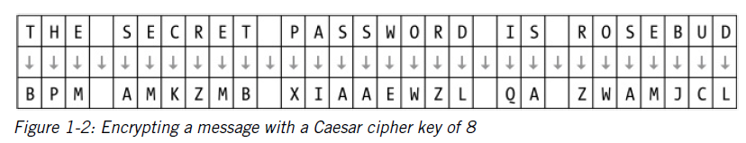
Encrypting with the Cipher Wheel
For example, in Figure 1-1 (slide 17), the outer circle’s A is over the inner circle’s number 8.
We’ll use this encryption key to encrypt the message in our example, as shown in Figure 1-2.

Slide 22
For each letter in the message, find it in the outer circle and replace it with the corresponding letter in the inner circle.
In this example, the first letter in the message is T (from "THE SECRET...").
Locate T in the outer circle and find its corresponding letter in the inner circle, which is B.
Repeat this process for each letter in the message.

Slide 23
Encrypting with the Cipher Wheel
Message: THE SECRET PASSWORD IS ROSEBUD
Encryption Key:
T ➔ B
H ➔ P
E ➔ M
(Continue this process for all letters)
Result: BPM AMKZMB XIAAEWZL QA ZWAMJCL

Slide 24
Encrypting with the Cipher Wheel
Each letter on the outer wheel always encrypts to the same letter on the inner wheel.
After determining the encryption for the first occurrence of a letter (e.g., T ➔ B), apply the same encryption for all subsequent occurrences of that letter in the message.
Non-letter characters, such as spaces, remain unchanged during the encryption process.

Slide 25
Decrypting with the Cipher Wheel
For example, let’s say you receive the ciphertext IWT CTL EPHHLDGS XH HLDGSUXHW and want to decrypt it
You wouldn’t be able to decrypt the message unless you knew the key (or unless you were a
clever hacker).
Luckily, your friend has already told you that they use the key 15 for their messages. The cipher wheel for this key is shown in Figure 1-3 next slide

Slide 26
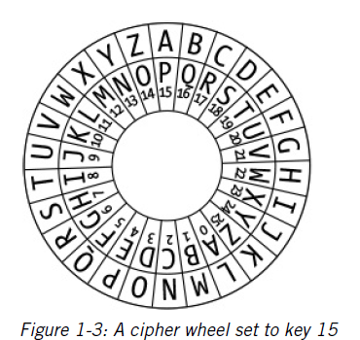
Decrypting with the Cipher Wheel
Now you can line up the letter A on the outer circle (the one with the dot below it) over the letter on the inner circle that has the number 15 (which is the letter P).
Then, find the first letter in the secret message on the inner circle, which is I, and look at the corresponding letter on the outer circle, which is T.
The second letter in the ciphertext, W, decrypts to the letter H.
Decrypt the rest of the letters in the ciphertext back to the plaintext, and
you’ll get the message THE NEW PASSWORD IS SWORDFISH, as shown in Figure 1-4 next slide

Slide 27
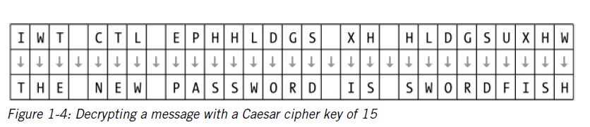
Decrypting with the Cipher Wheel
If you used an incorrect key, like 16, the decrypted message would be SGD MDV OZRRVNQC HR RVNQCEHRG, which is unreadable.
Unless the correct key is used, the decrypted message won’t be understandable.

Slide 28
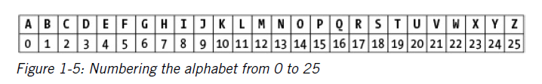
Encrypting and Decrypting with Arithmetic
The cipher wheel is a convenient tool for encrypting and decrypting with the Caesar cipher, but you can also encrypt and decrypt using arithmetic.
To do so, write the letters of the alphabet from A to Z with the numbers from 0 to 25 under each letter.
Begin with 0 under the A, 1 under the B, and so on until 25 is under the Z.
See Figure 1-5 shows what it should look like.

Slide 29
Encrypting and Decrypting with Arithmetic
You can use this letters-to-numbers code to represent letters. This is a powerful concept, because it allows you to do math on letters.
For example, if you represent the letters CAT as the numbers 2, 0, and 19:
you can add 3 to get the numbers 5, 3, and 22.
These new numbers represent the letters FDW, as shown in Figure 1-5 in the previous slide.
You have just “added” 3 to the word cat!
Later, we’ll be able to program a computer to do this math for us.

Slide 30
Encrypting process with Arithmetic
Use arithmetic to encrypt with the Caesar cipher.
Find the number under the letter you want to encrypt.
Add the key number to it.
The resulting sum is the number under the encrypted letter.

Slide 31
Example Encryption
Encrypting "HELLO. HOW ARE YOU?" using the key 13.
Find the number under H (7), add 13: 7 + 13 = 20 (U).
E (4) + 13 = 17 (R), and so on.
When the sum exceeds 25, subtract 26 from it.
O (14) + 13 = 27, 27 - 26 = 1 (B).
Message: "HELLO. HOW ARE YOU?"
Result: "URYYB. UBJ NER LBH?"

Slide 32
Decryption Process:
To decrypt, subtract the key instead of adding it.
Find the number of the ciphertext letter.
Subtract the key.
If the result is less than 0, add 26 to it.

Slide 33
Example Decryption
Decrypting "URYYB" using the key 13.
U (20) – 13 = 7 => H …etc
B (1) - 13 = -12, add 26: -12 + 26 = 14 (O).
Message: "URYYB"
Result: "HELLO
As you can see, you don’t need a cipher wheel to use the Caesar cipher.
All you need is a pencil, a piece of paper, and some simple arithmetic!

Slide 34
Can we double encrypt with the Ceasar cipher?
Many people believe that encrypting a message twice with two different keys would double the strength of the encryption. However, this is not the case with the Caesar cipher and most other ciphers.
Let's explore why double encryption doesn't increase security in the Caesar cipher.

Slide 35
Example 1: Single Encryption
Encrypt the word "KITTEN" using the key 3.
Add 3 to the plaintext letter's number.
Resulting ciphertext: NLWWHQ

Slide 36
Example 2: Double Encryption
Encrypt "KITTEN" with the key 3, resulting in "NLWWHQ."
Encrypt "NLWWHQ" with the key 4.
Add 4 to the plaintext letter's number.
Resulting ciphertext: RPAALU

Slide 37
Observation:
The result of double encryption (KITTEN ➔ NLWWHQ ➔ RPAALU) is the same as a single encryption with a key of 7 (KITTEN ➔ RPAALU).
For the Caesar cipher, and many other ciphers, double encryption does not provide additional strength.
The result of double encryption can be achieved with a single encryption using a different key.

